Slide 1
The Technology Value Stream
By: Hugo Ramirez

Slide 2
Defining Lead Time vs. Processing Time
Lead Time: Total time from the moment the request is issued in till completion.
Processing Time: Time actively spent working on the request.
Lead Time is what customer experiences when making a request

Slide 3
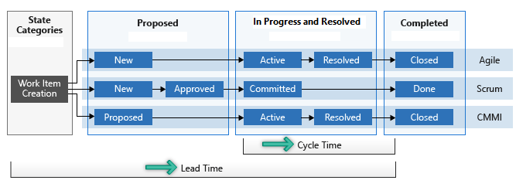
Diagram:
Lead Time vs. Processing Time

Slide 4
Common Scenario: Deployment Lead Times Requiring Months
Large organizations often experience months-long deployment lead times.
Bottlenecks are caused by manual testing, approval delays, and tightly coupled systems.
Long lead times often require heroics at the end of development cycles.

Slide 5
DevOps Ideal:
Deployment Lead Times of Minutes
DevOps focuses on automation, fast feedback, and continuous improvement.
Small code changes are validated and deployed regularly.
Reduces risk, increases stability, and delivery speed is increased.

Slide 6
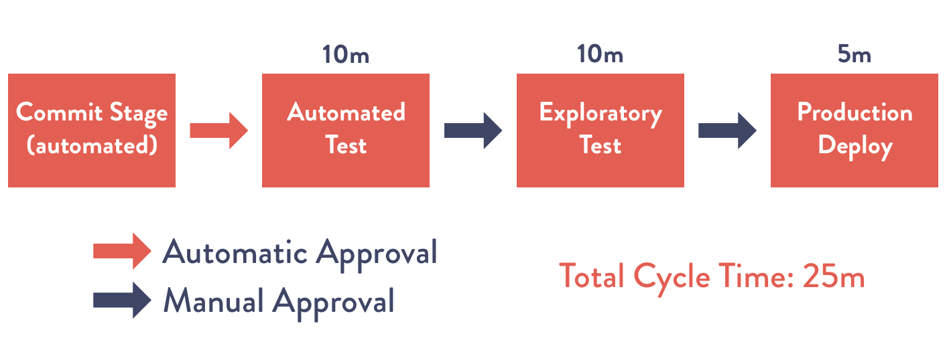
Diagram:
DevOps Deployment in Minutes

Slide 7
Summary
Lead Time vs. Processing Time helps identify delays and can help improve the process.
Traditional processes often produce months-long deployments.
DevOps practices try to reduce deployment times to minutes and reduce risk of failures.

Slide 8
References
Kim, G., Humble, J., Debois, P., & Willis, J. (2021). The DevOps handbook (2nd edition.).
Kim, G., Humble, J., Debois, P., & Willis, J. (2021). The DevOps handbook (2nd edition., Figure 1.3, p. 11).
Microsoft Cycle time and lead time diagram. Microsoft Learn.
https://learn.microsoft.com/en-us/azure/devops/report/dashboards/media/cycle-lead-time-concept-intro.png?view=azure-devops

